Slide 1
Recidivism
Describe the intent of the data science model behind the Northpointe algorithm?
What population, data do you think they used for training?
What was the target, the features?
Do you think it is a good idea to use a model like this to help judges and courts determine criminal sentences?
What are the false positives/negatives in this predictive model? What are the costs of each? Which is worse? How would you consider going about setting a threshold?
They did not use race in their model, so why do you think the results are so different for race?
Do you have thoughts on how to correct for the apparent racial bias?
Or other thoughts on how to use data science fairly for this particular task?
Notes:
Education and employment
Article: “Only 20 percent of the people predicted to commit violent crime went on to do so” – what is that? Also followup accuracy statement
Using traits like intelligence, introversion and extroversion for to build assessment scores.
The problem is that the score is solely being used, instead of being taken into account with other factors.
Do you think adding race as an explicit feature would create more racial disparity, or allow us to correct for racial disparity?
Can you relate this to PM decisions…rolling out cell towers – model says to place them in rich areas

Slide 2
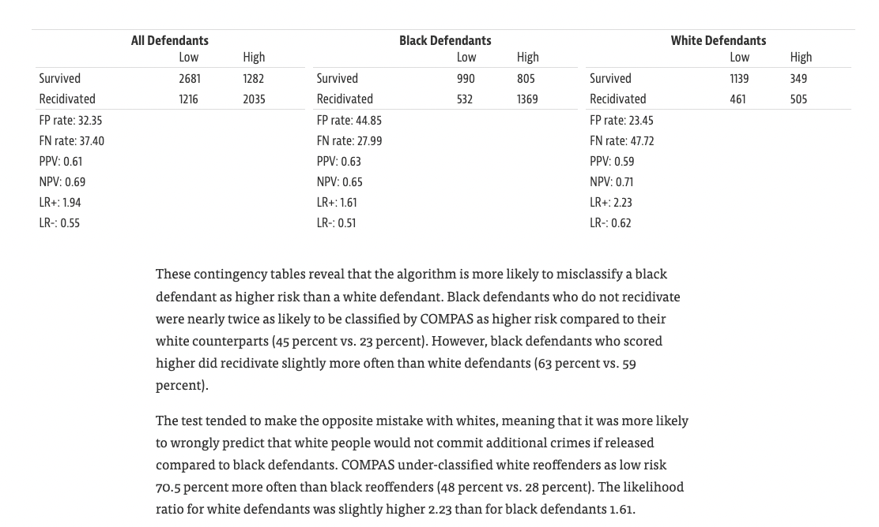
https://en.wikipedia.org/wiki/Confusion_matrix
Notes:
Precision measures FP related to TP
Precision Black = 1369/2174 = 63% recall=72
Precision White = 59% = 505/854 recall=52
FPR = 805 / (805+990) measures FP related to TN (of those that are truly negative)
Compas is saying that a False Postive
The model is more likely to correctly predict recid for blacks, but it is also more likely to incorrectly predict recidivism for blacks – because it is more like to predict pos for blacks overall!
For those that truly did not re-offend, blacks were more likely to be predicted as offenders
This is because of the overall baserate of black recidivism.

Slide 3
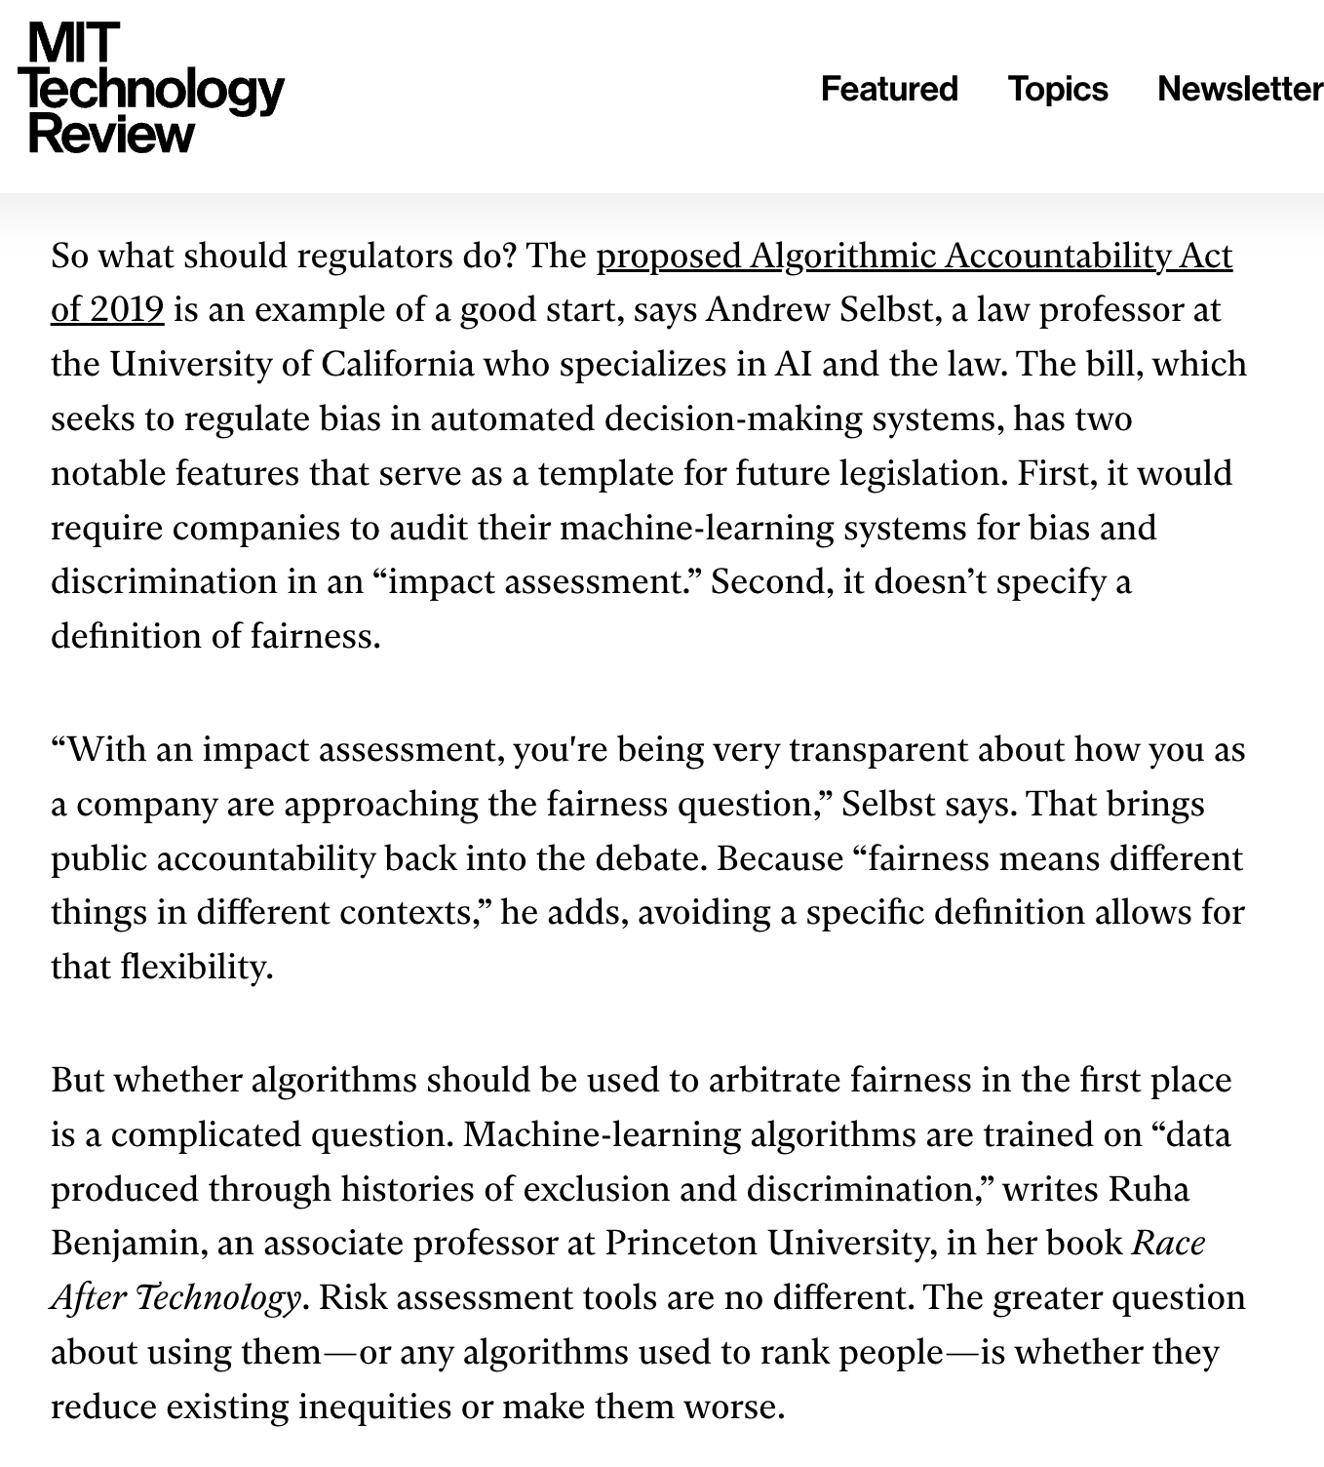
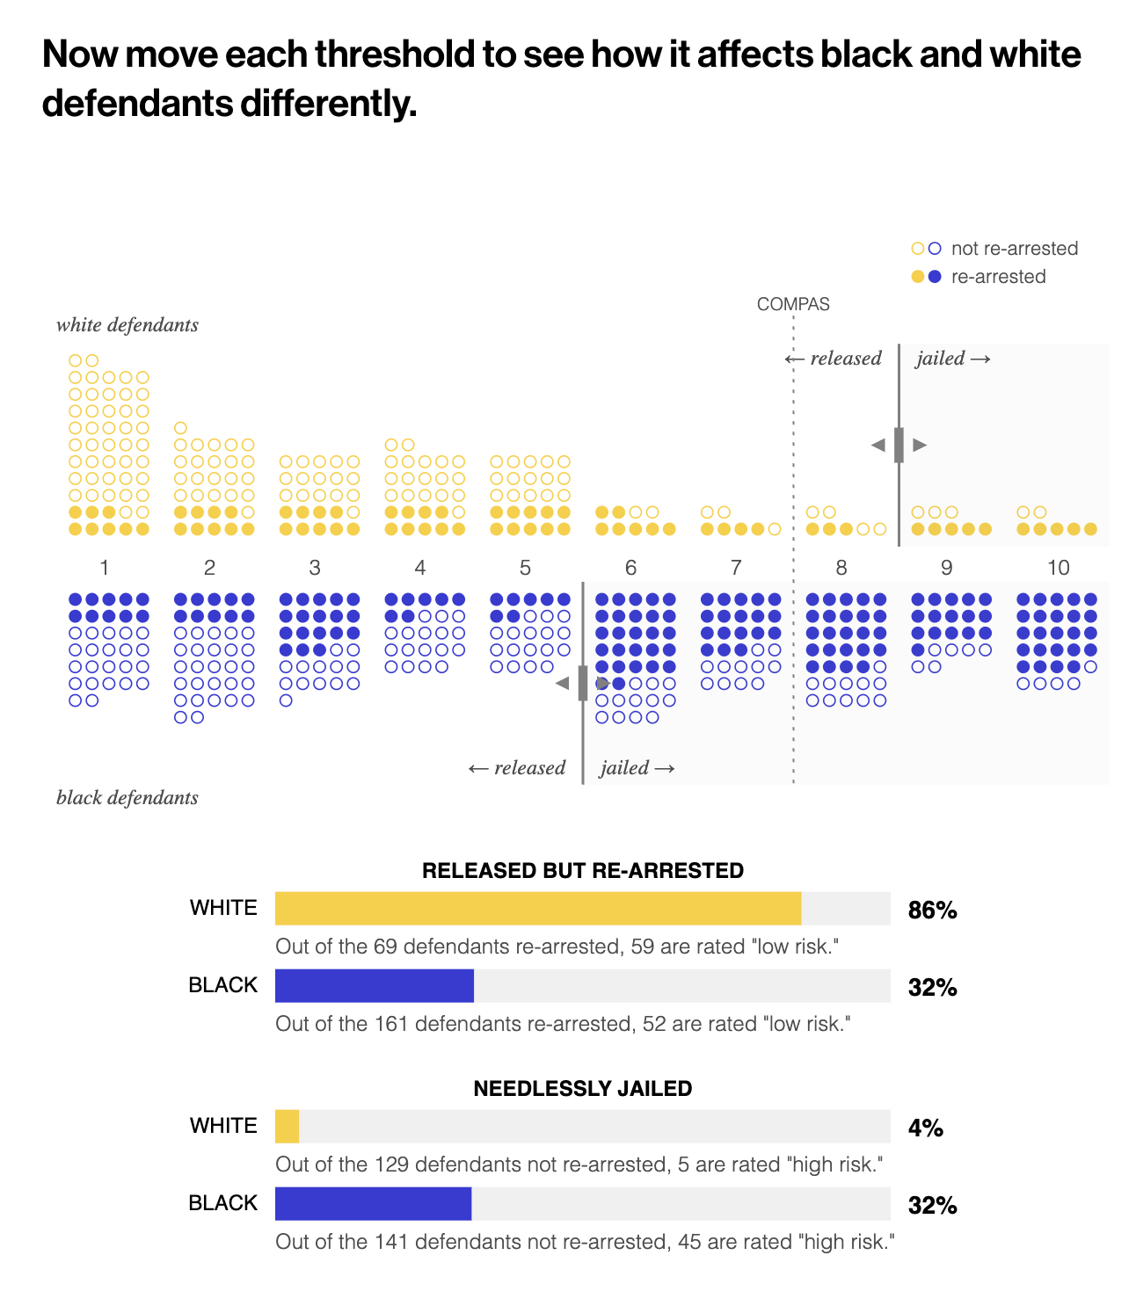
MIT Tech Review – COMPAS game

